Slide 1
Kickstarter Data Science Analysis
Students:
Khaled Al Hariri – 1801284
Yousef Elbayoumi – 1722326
Bora Bilgin – 1729464
Elnur Seyidov – 1805676

Slide 2
TABLE OF CONTENTS
01
04
02
05
03
06
Dataset Explanation
Data Transformation
We will explain the data set and its features in a brief manner.
We will explain scaling and aggregation methods.
Data Visualization
Modelling
We will explain the graphs shown in the report.
We will explain the different models we trained.
Data Preprocessing
Conclusion
We will explain how we formatted cleaned and encoded the data.

Slide 3
Dataset Explanation
Kickstarter is a website that allows small start-ups and businesses to share their product and get pledged donations from different people in order to start producing it.
This dataset contains different attributes related to these projects such as category, pledged amount, project goal and project state.
Our goal is to present these attributes in a way to visually show how the project is doing and its status.
Dataset Link: https://www.kaggle.com/kemical/kickstarter-projects/version/3

Slide 4
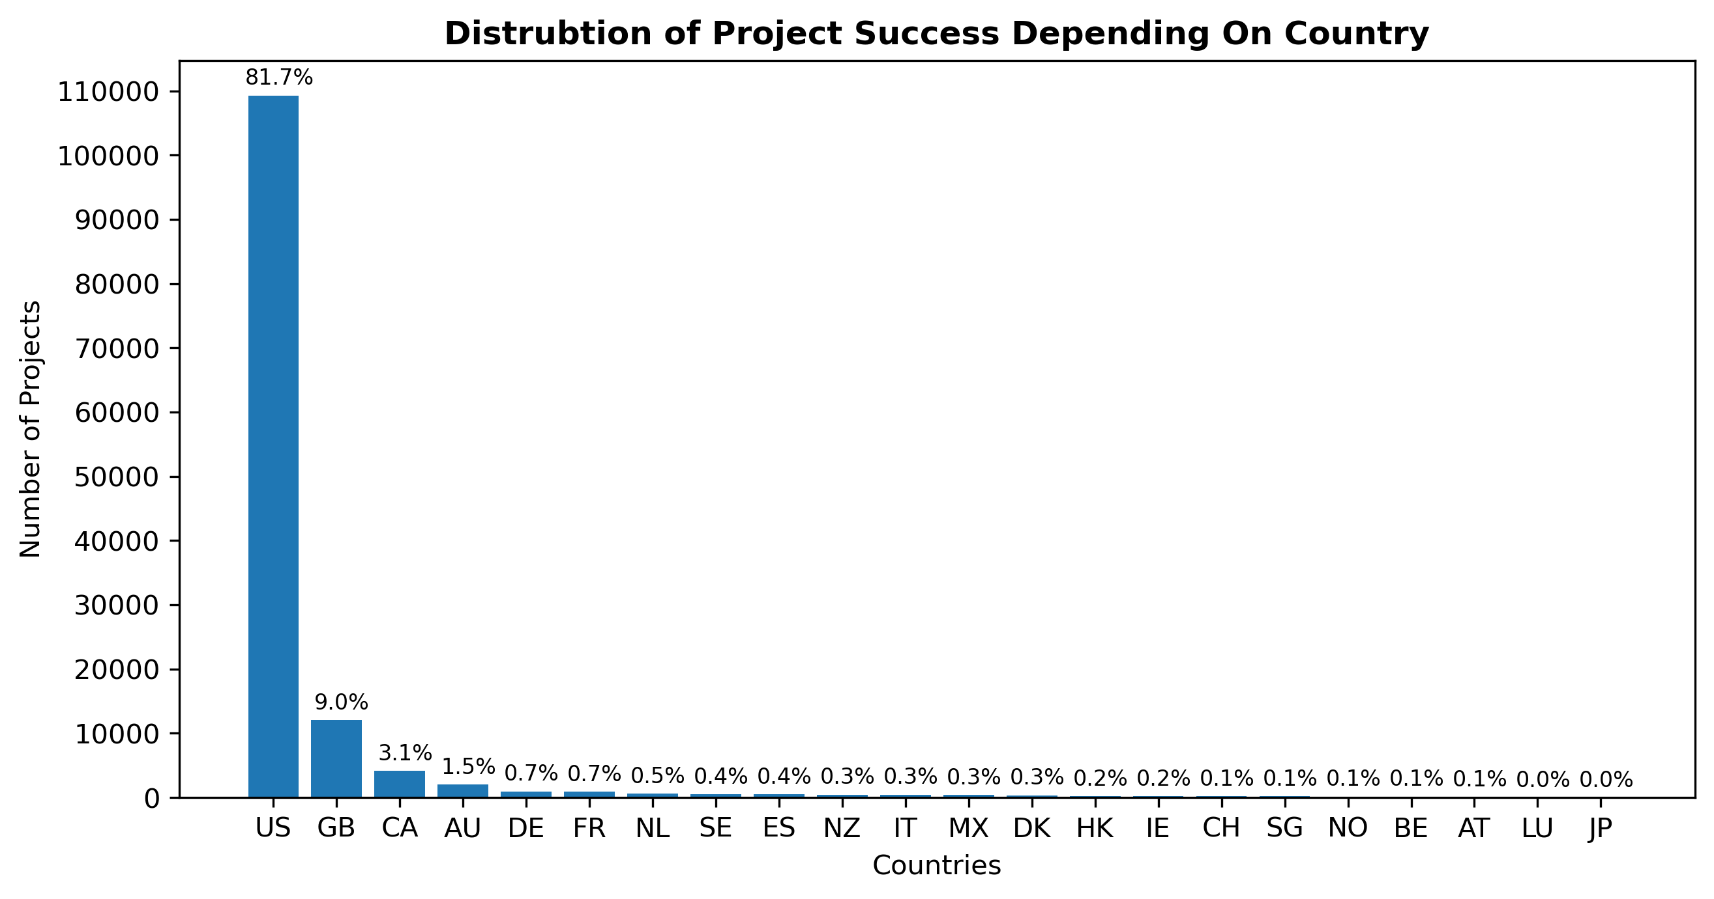
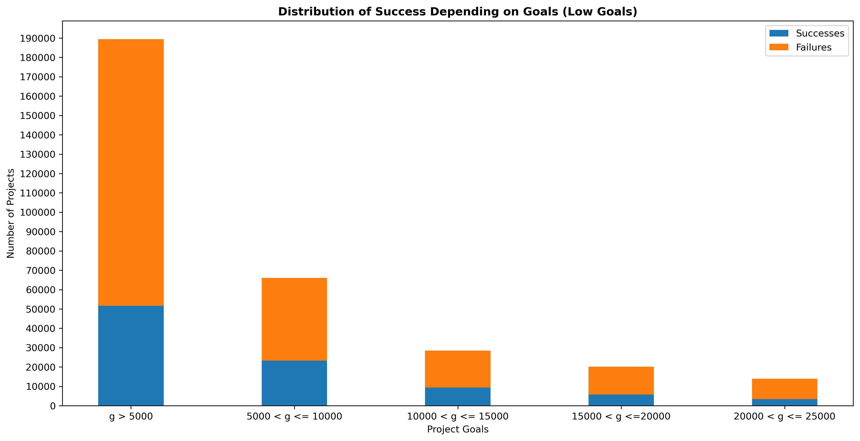
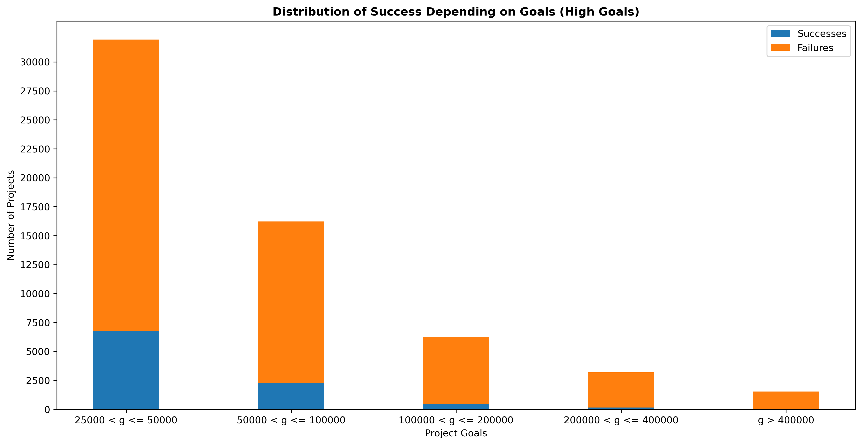
Data Visualization

Slide 5
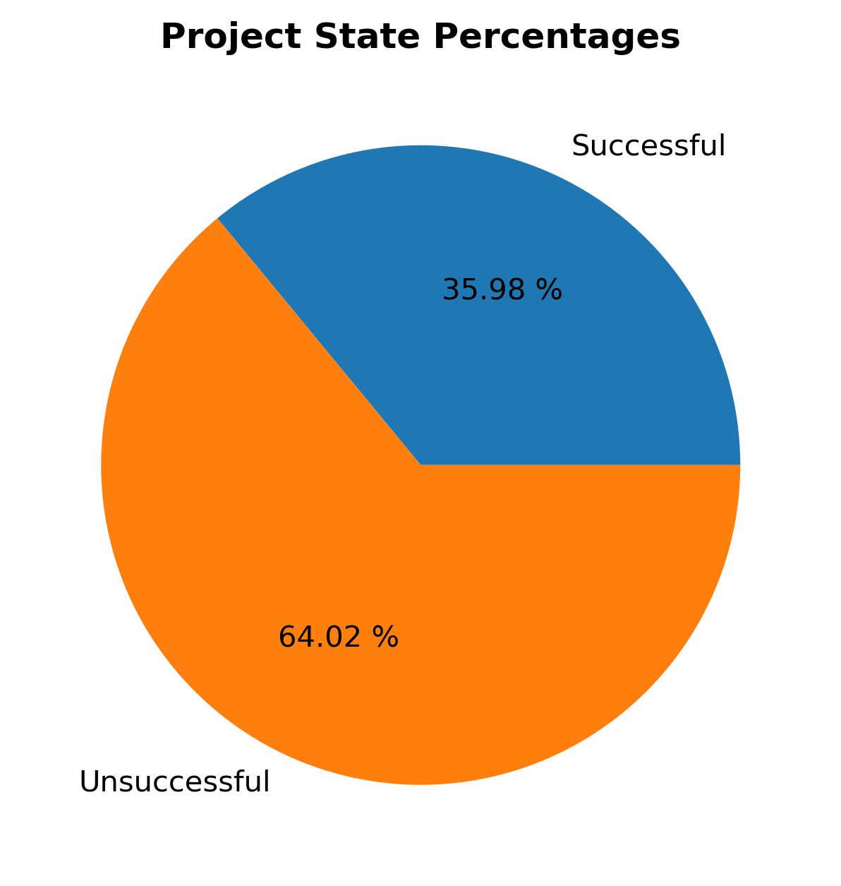
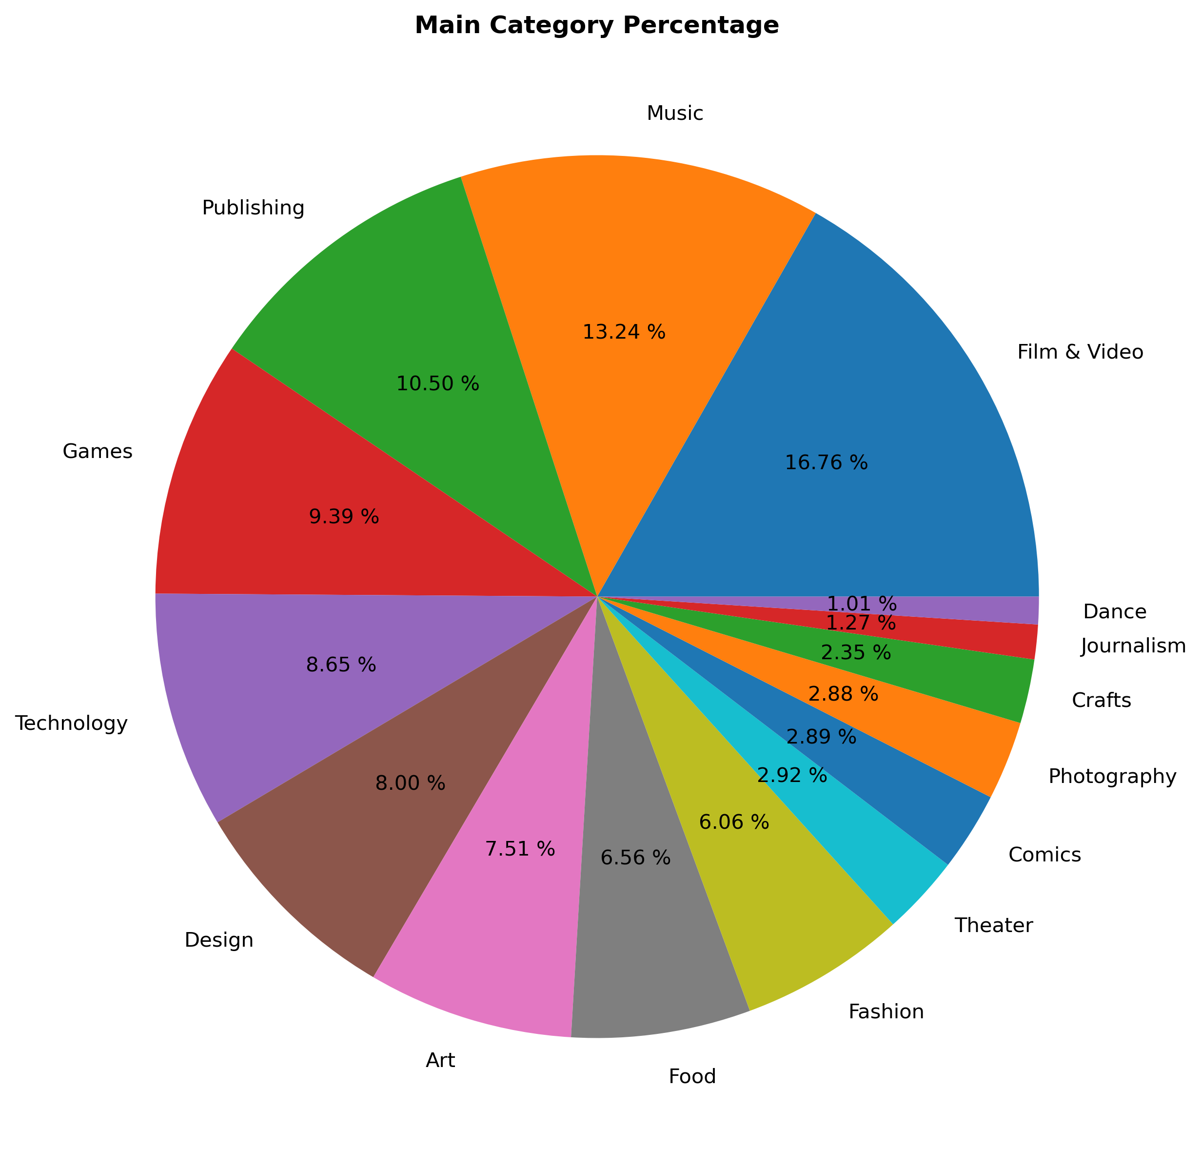
Data Visualization

Slide 6
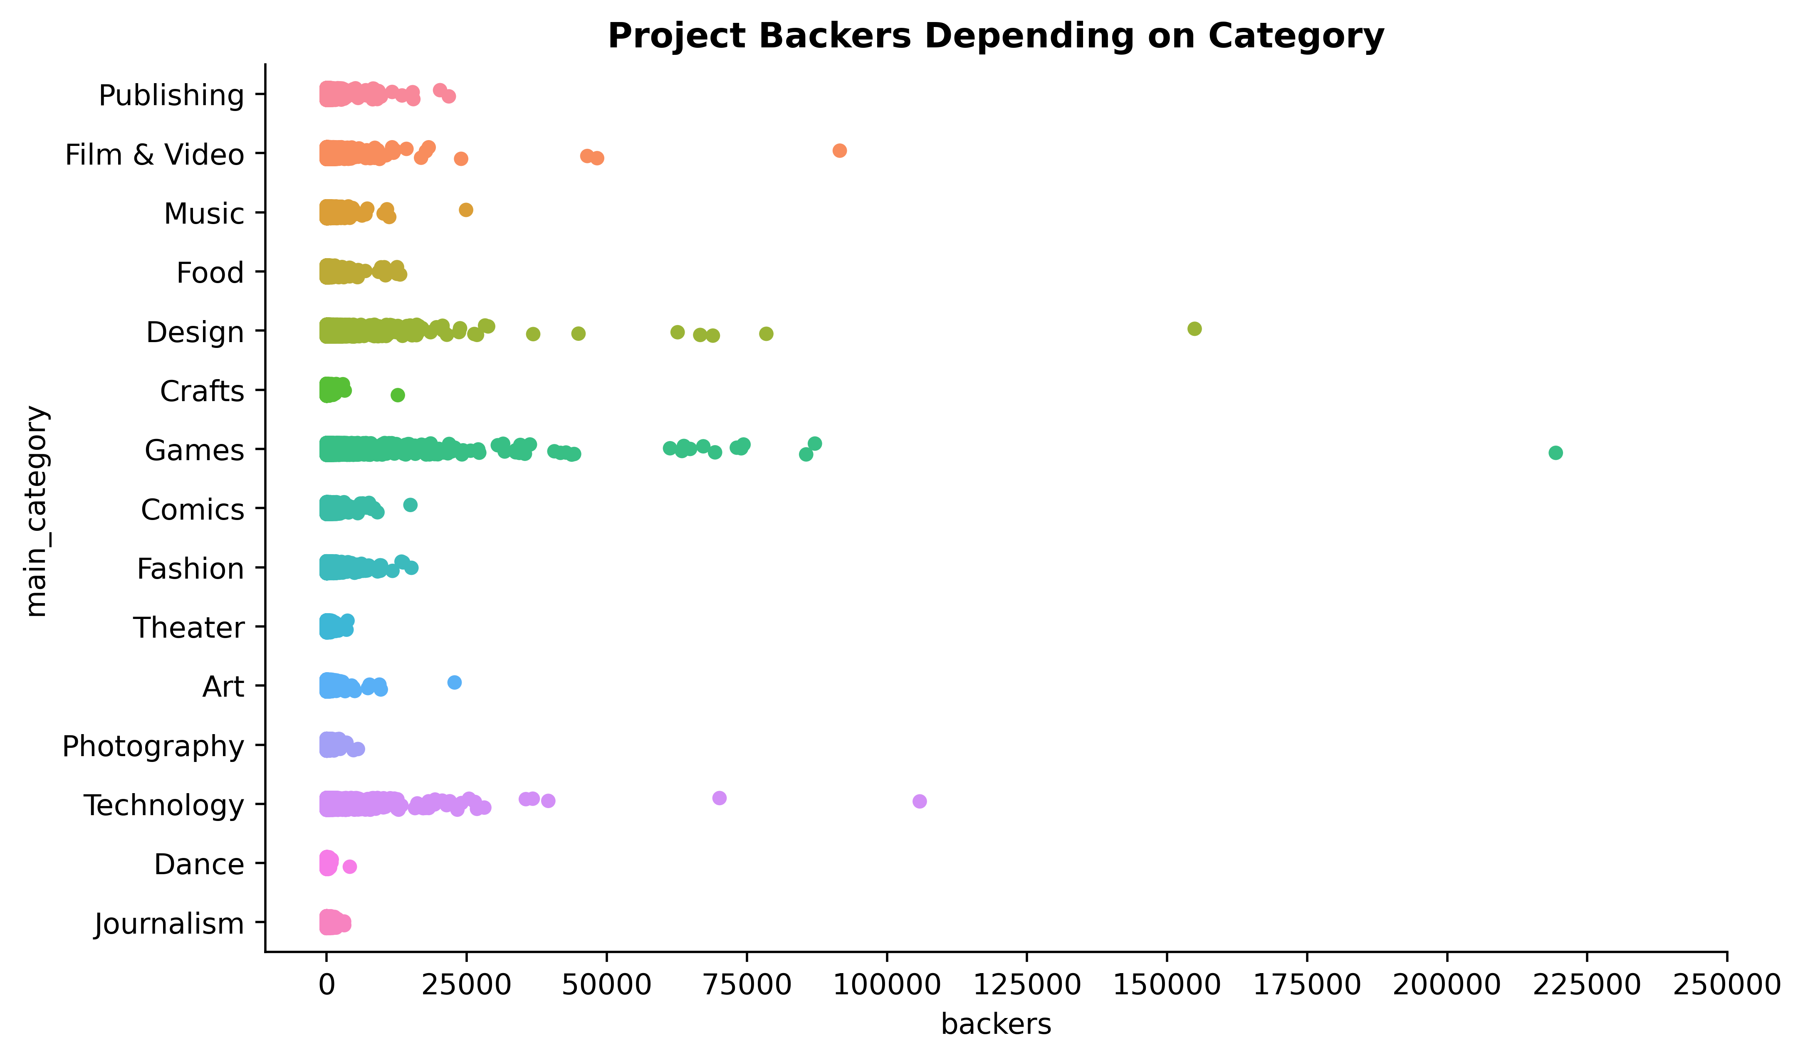
Data Visualization

Slide 7
Data Preprocessing
Formatting: Unneeded features were removed such as launched, currency and deadline. To avoid confusion all pledged and goal columns were removed except for usd_goal_real and usd_pledged_real.
Cleaning: All the null values were attributed to a country named N,0” which was an error caused by Kickstarter. Therefore, all rows with that country were removed. Project name null values were changed to “unknown”.
Sampling: Samples were taken with repetition and without. The sample with no repetition was later used for modelling along the population data.
Encoding: One hot encoding was used to change the state column to successful with binary values. Country feature was changed to continent then divided into 3 columns using one hot encoding.

Slide 8
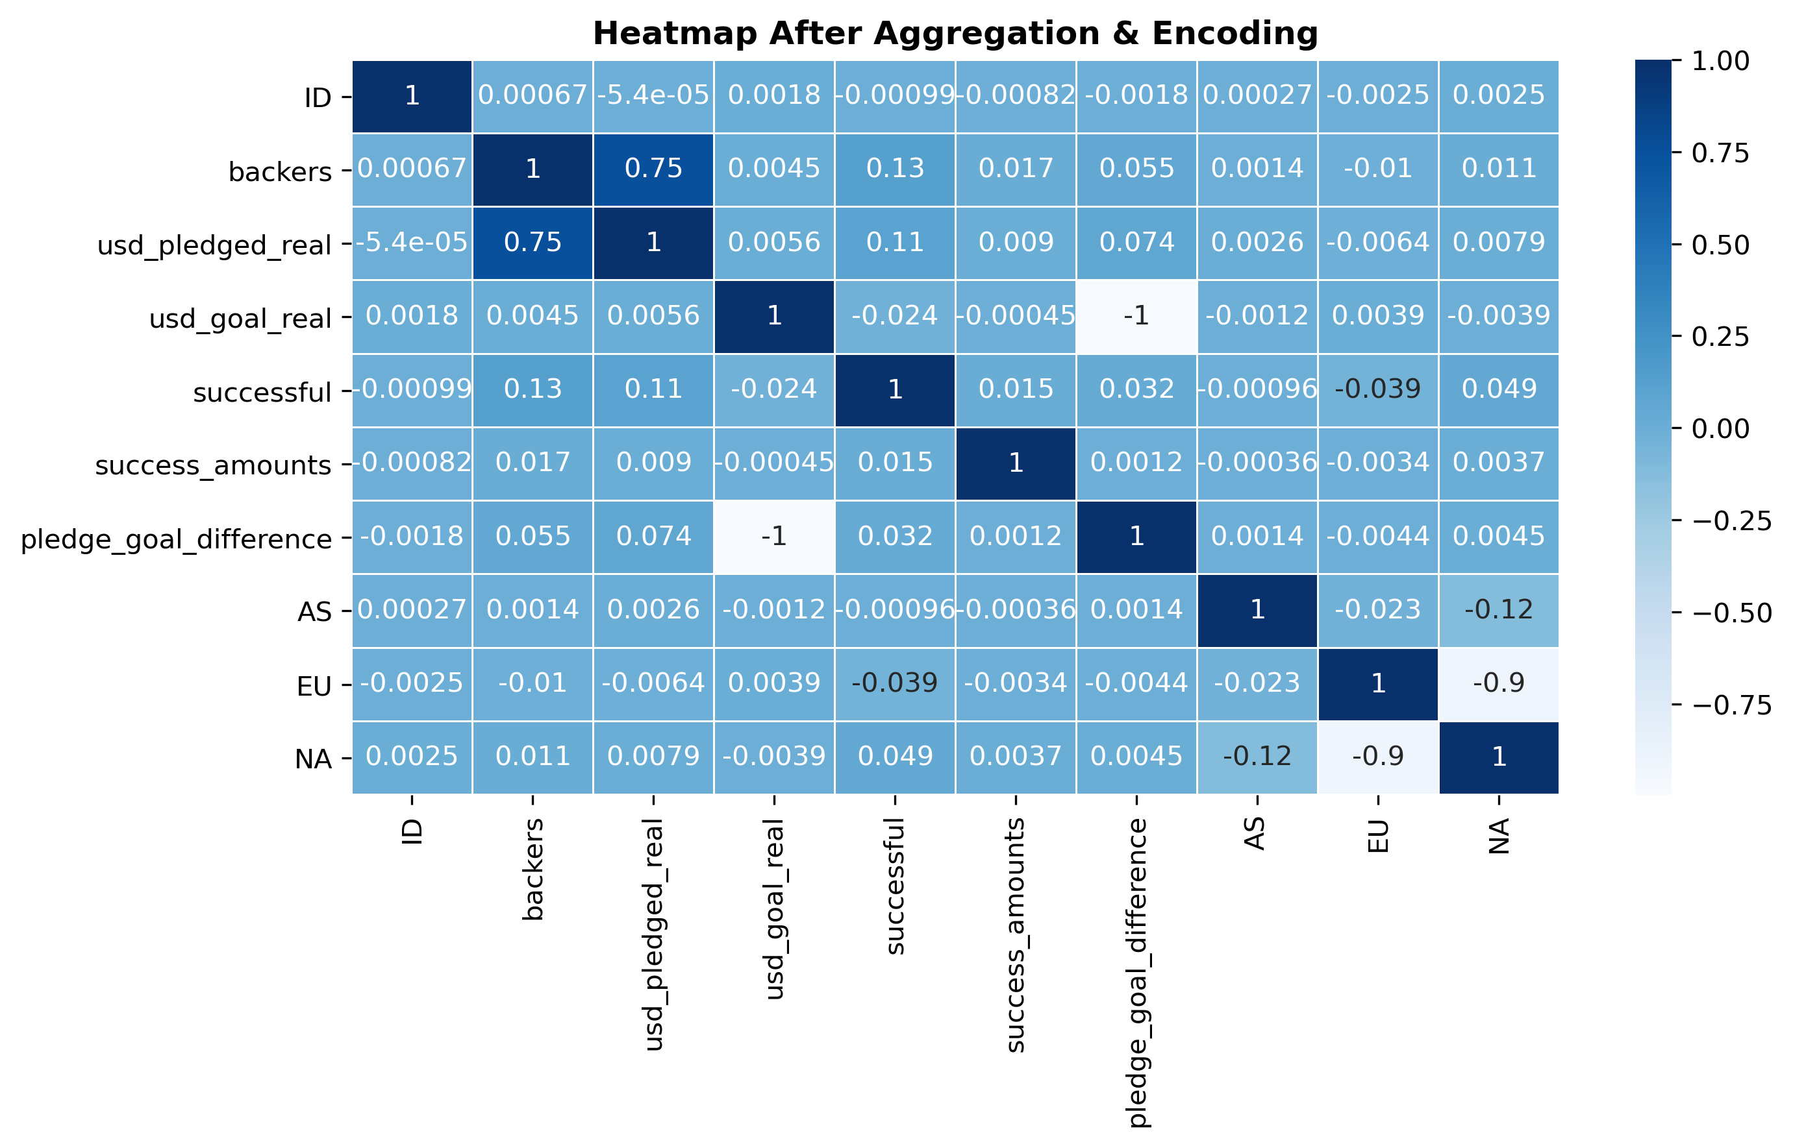
Data Transformation
Aggregation: We created 2 new columns by doing calculations between the goal and pledge columns. The first is success_amounts and the second is pledge_goal_difference.
Scaling: We used standardization to scale the data before using it in the modelling part.

Slide 9
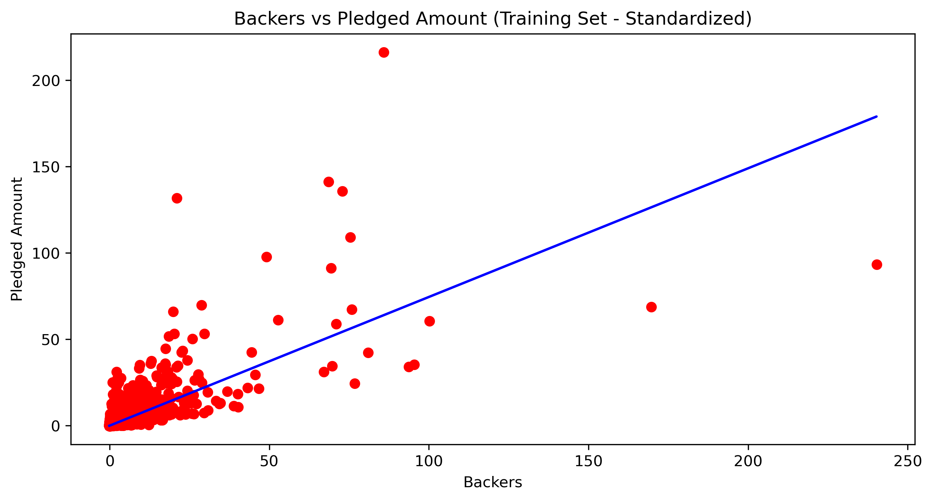
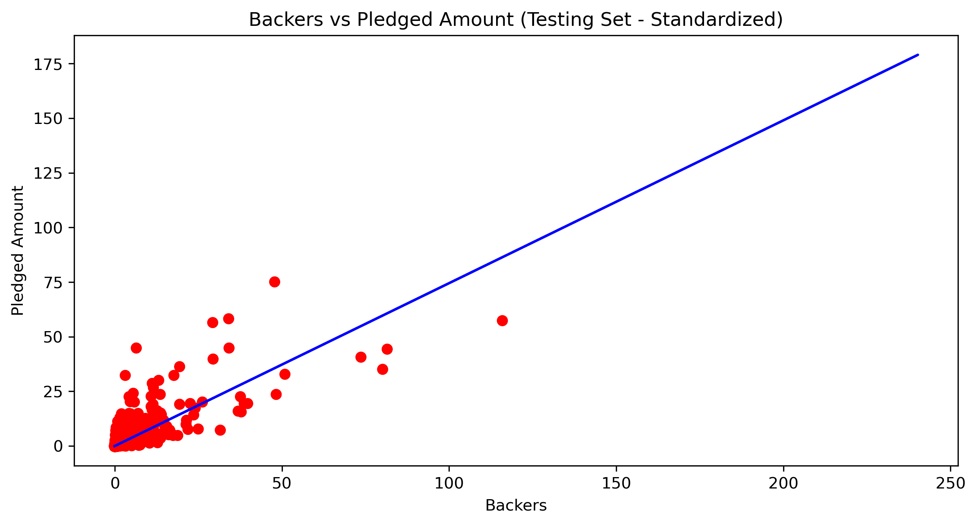
Modelling
Feature Selection: Low variance method was used to determine which features to remove. However, all we got were encoded categorical columns so none were removed.
Cross Validation: The data was split into training and testing sets. The models trained are Linear Regression, Polynomial Regression, Decision Tree and Random Forest.

Slide 10
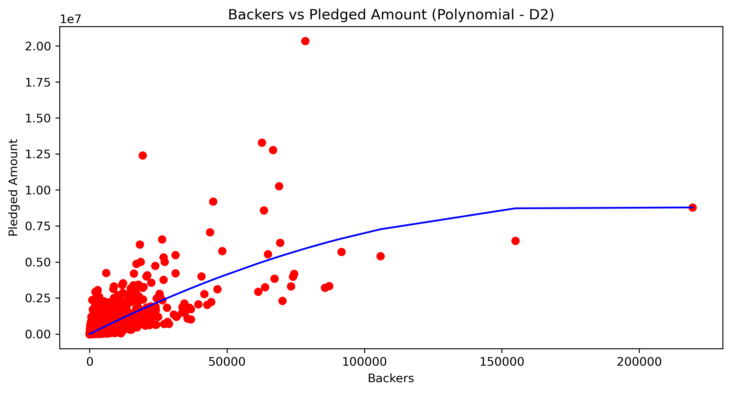
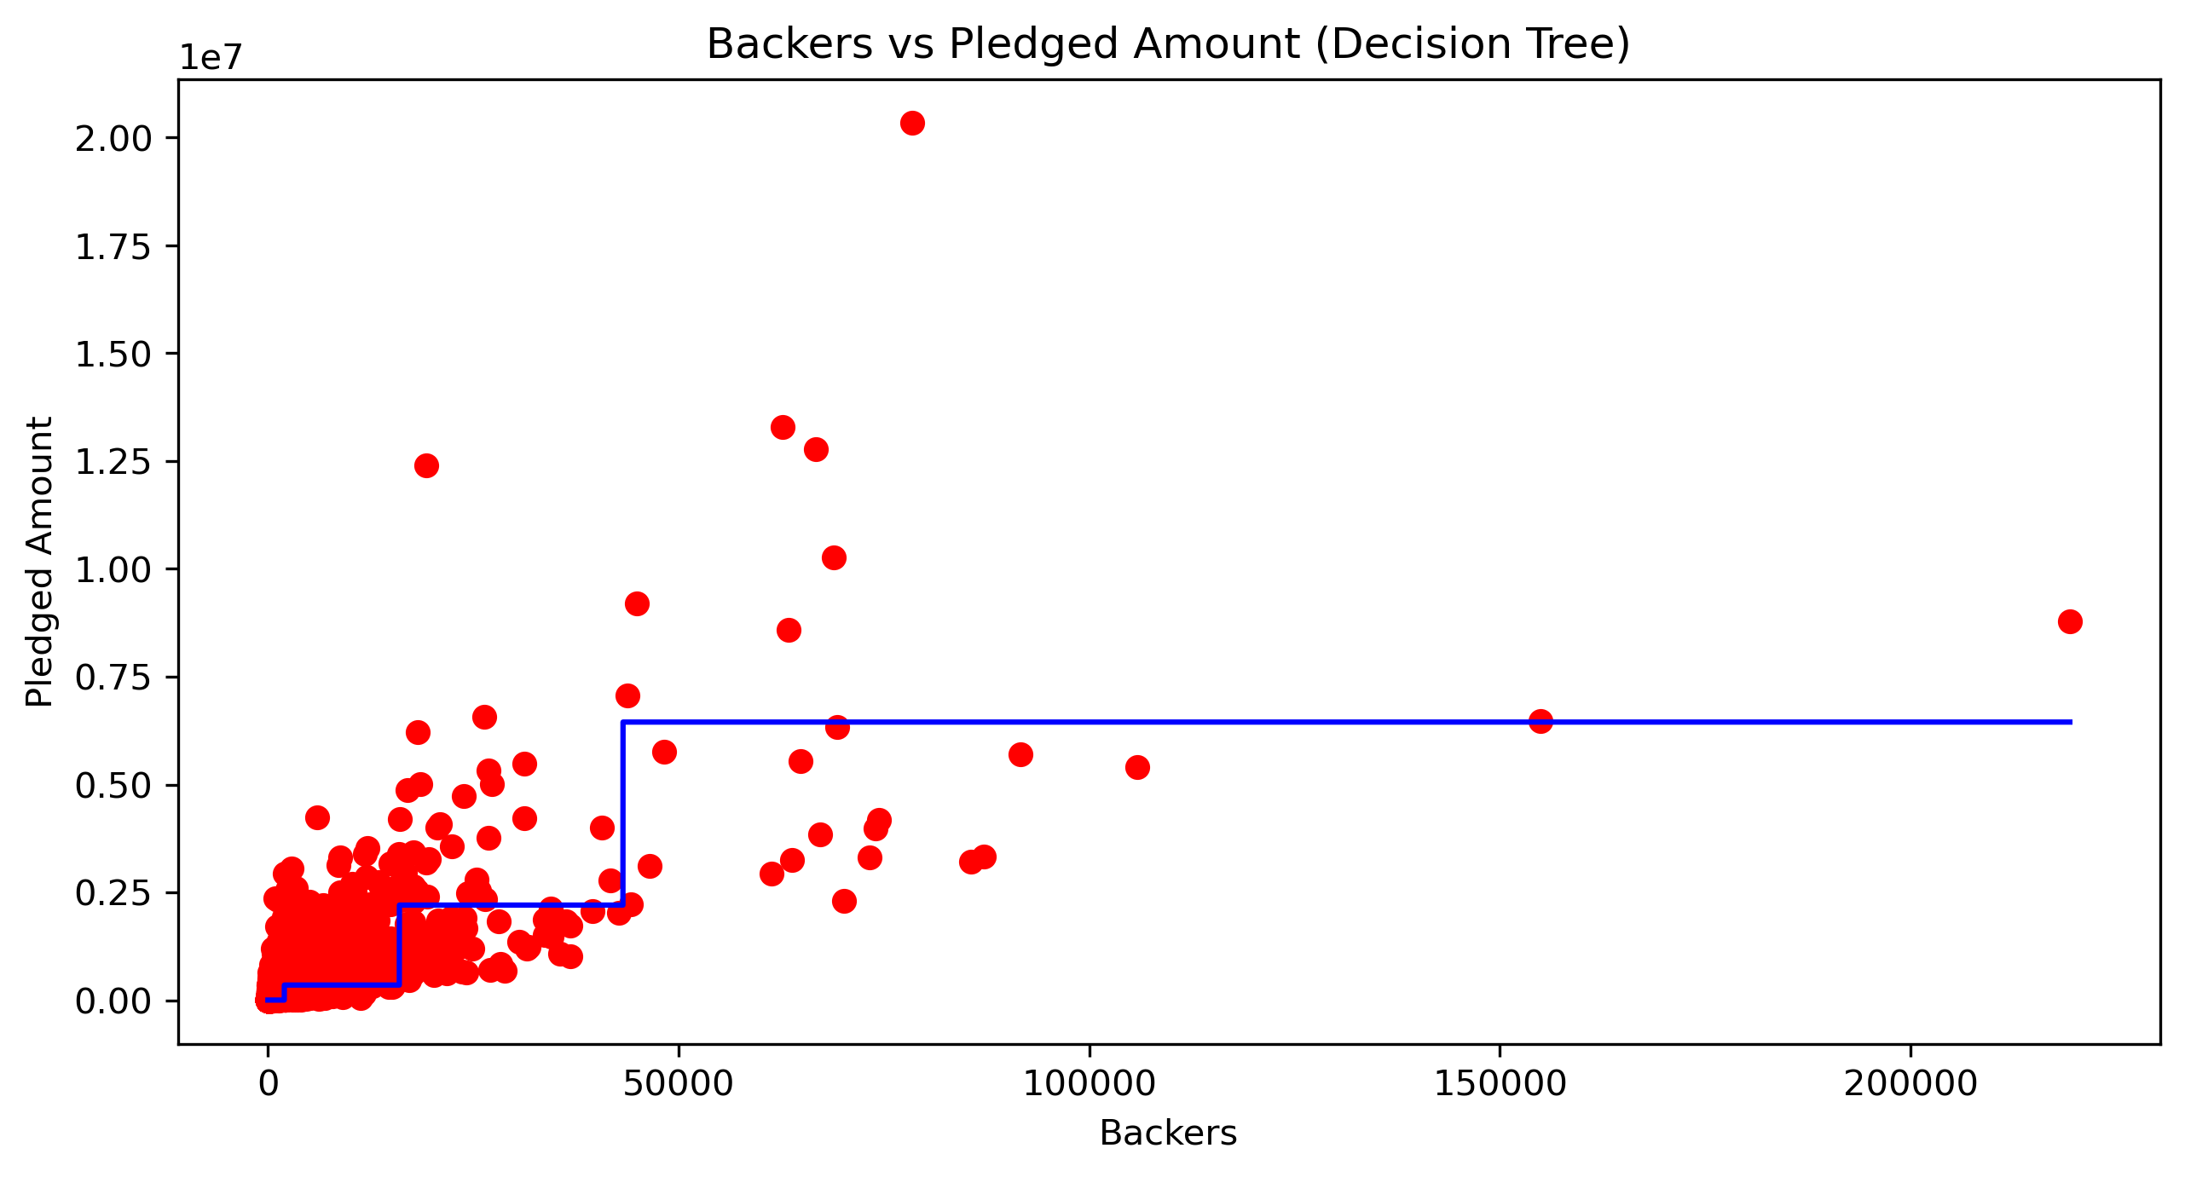
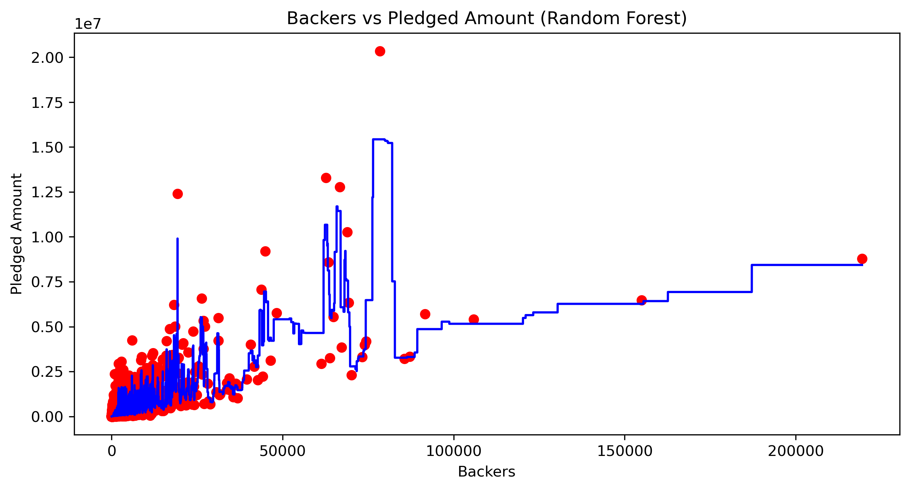
Modelling
Polynomial, Decision Tree and Random Forest models:

Slide 11
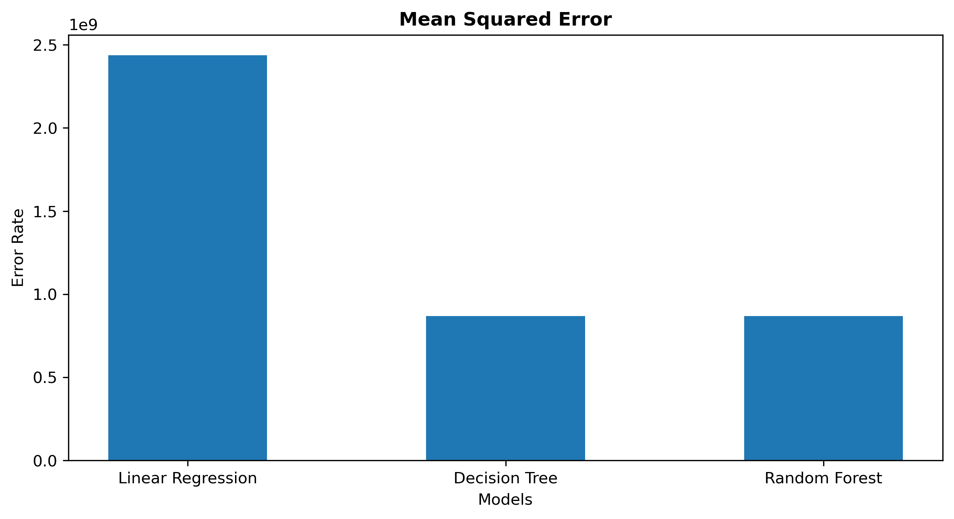
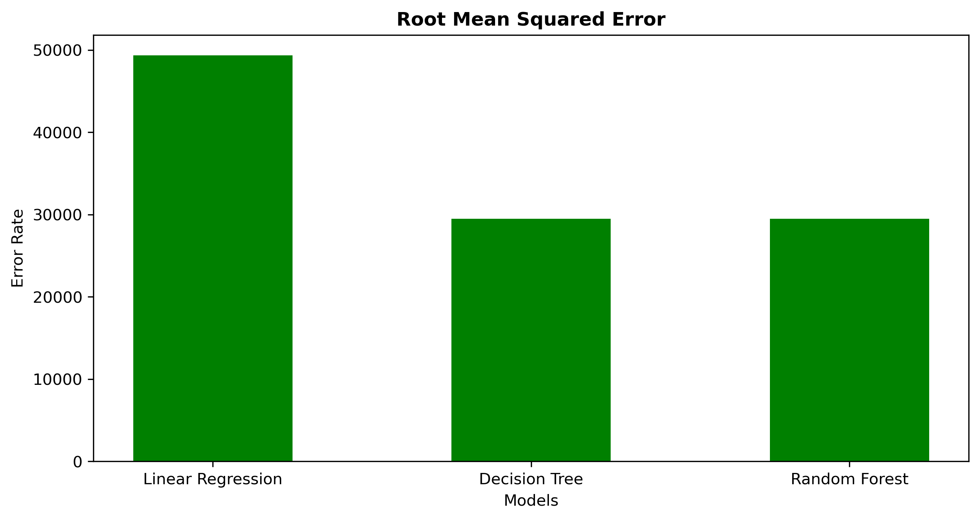
Modelling
Error rates:

Slide 12
THANKS!

